Slide 1




University Institute of Engineering
Department of Computer Science & Engineering
COMPUTER ORGANIZATION & ARCHITECTURE
(23CST-204/23ITT-204)
ER. SHIKHA ATWAL
E11186
ASSISTANT PROFESSOR
BE-CSE

Slide 2
MODES OF TRANSFER
Data transfer to and from the peripherals may be done in any of the three possible ways
Programmed I/O
Interrupt-driven I/O
Direct memory access (DMA)

Slide 3
2. Interrupt-driven I/O
Interrupt driven I/O is an alternative scheme dealing with I/O. Interrupt I/O is a way of controlling input/output activity whereby a peripheral or terminal that needs to make or receive a data transfer sends a signal. This will cause a program interrupt to be set.
At a time appropriate to the priority level of the I/O interrupt relative to the total interrupt system, the processors enter an interrupt service routine. The function of the routine will depend upon the system of interrupt levels and priorities that is implemented in the processor. The interrupt technique requires more complex hardware and software, but makes far more efficient use of the computer’s time and capacities. Figure below shows the simple interrupt processing.

Slide 4
Isolated I/O | Memory Mapped I/O
Isolated I/O uses separate memory space. | Memory mapped I/O uses memory from the main memory.
Limited instructions can be used. Those are IN, OUT, INS, OUTS. | Any instruction which references to memory can be used.
The address for Isolated I/O devices are called ports | Memory mapped I/O devices are treated as memory locations on the memory map.
For input, the device interrupts the CPU when new data has arrived and is ready to be retrieved by the system processor. The actual actions to perform depend on whether the device uses I/O ports or memory mapping.

Slide 5
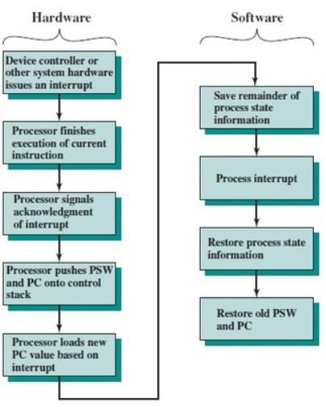
For output, the device delivers an interrupt either when it is ready to accept new data or to acknowledge a successful data transfer. Memory-mapped and DMA-capable devices usually generate interrupts to tell the system they are done with the buffer.
Here the CPU works on its given tasks continuously. When an input is available, such as when someone types a key on the keyboard, then the CPU is interrupted from its work to take care of the input data. The CPU can work continuously on a task without checking the input devices, allowing the devices themselves to interrupt it as necessary.

Slide 6
Basic Operations of Interrupt
CPU issues read command.
I/O module gets data from peripheral whilst CPU does other work.
I/O module interrupts CPU.
CPU requests data.
I/O module transfers data.

Slide 7
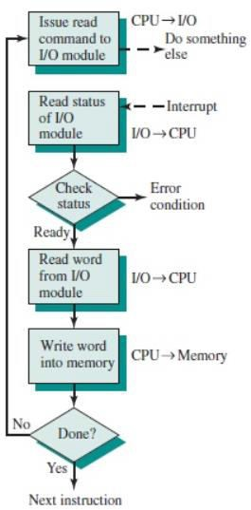
Interrupt Processing
A device driver initiates an I/O request on behalf of a process.
The device driver signals the I/O controller for the proper device, which initiates the requested I/O.
The device signals the I/O controller that is ready to retrieve input, the output is
complete or that an error has been generated.
The CPU receives the interrupt signal on the interrupt-request line and transfer control over the interrupt handler routine.

Slide 8
5. The interrupt handler determines the cause of the interrupt, performs the necessary processing and executes a “return from” interrupt instruction.
The CPU returns to the execution state prior to the interrupt being signalled.
The CPU continues processing until the cycle begins again.

Slide 9
Advantages of Interrupt-Driven I/O
Fast
Efficient
Disadvantages of Interrupt Drive I/O
can be tricky to write if using a low-level language
can be tough to get various pieces to work well together
usually done by the hardware manufacturer / OS maker, e.g. Microsoft

Slide 10
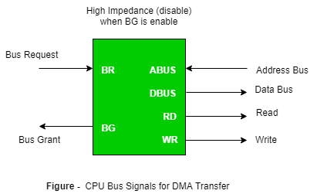
3. Direct Memory Access (DMA)
The data transfer between a fast storage media such as magnetic disk and memory unit is limited by the speed of the CPU. Thus we can allow the peripherals directly communicate with each other using the memory buses, removing the intervention of
the CPU. This type of data transfer technique is known as DMA or direct memory access. During DMA the CPU is idle and it has no control over the memory buses. The DMA controller takes over the buses to manage the transfer directly between the I/O devices and the memory unit.

Slide 11
DMA
Large blocks of data transferred at a high speed to or from high-speed devices, magnetic drums, disks, tapes, etc.
DMA controller Interface that provides I/O transfer of data directly to and from the memory and the I/O device
CPU initializes the DMA controller by sending a memory address and the number of words to be transferred
Actual transfer of data is done directly between the device and memory through DMA controller -> Freeing CPU for other tasks
The transfer of data between the peripheral and memory without the interaction of CPU and letting the peripheral device manage the memory bus directly is termed as Direct Memory Access (DMA).

Slide 12
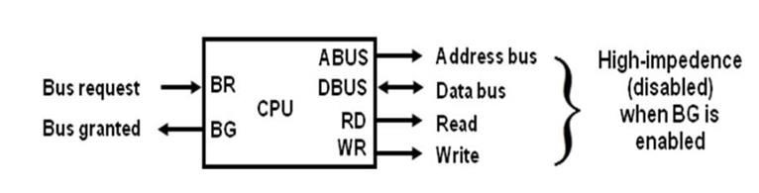
The two control signals Bus Request and Bus Grant are used to fascinate the DMA transfer. The bus request input is used by the DMA controller to request the CPU for the control of the buses. When BR signal is high, the CPU terminates the execution of the current instructions and then places the address, data, read and write lines to the high impedance state and sends the bus grant signal. The DMA controller now takes the control of the buses and transfers the data directly between memory and I/O without processor interaction.
CPU bus signal for DMA transfer
When the transfer is completed, the bus request signal is made low by DMA. In response to which CPU disables the bus grant and again CPU takes the control of address, data, read and write lines.

Slide 13
The transfer of data between the memory and I/O of course facilitates in two ways which are DMA Burst and Cycle Stealing.
DMA BURST: The block of data consisting a number of memory words is transferred at a time.
CYCLE STEALING: DMA transfers one data word at a time after which it must return control of the buses to the CPU.
CPU is usually much faster than I/O (DMA), thus CPU uses the most of the memory cycles
DMA Controller steals the memory cycles from CPU
For those stolen cycles, CPU remains idle
For those slow CPU, DMA Controller may steal most of the memory cycles which may cause CPU remain idle long time

Slide 14
DMA CONTROLLER
The DMA controller communicates with the CPU through the data bus and control lines. DMA select signal is used for selecting the controller, the register select is for selecting the register.
When the bus grant signal is zero, the CPU communicates through the data bus to read or write into the DMA register. When bus grant is one, the DMA controller takes the control of buses and transfers the data between the memory and I/O.

Slide 15
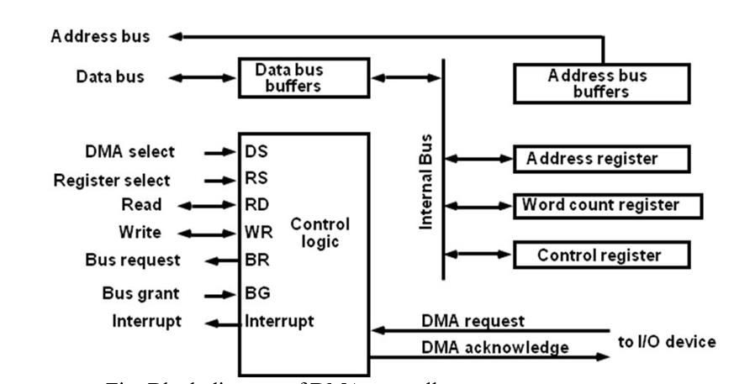
Block diagram of DMA controller

Slide 16
The address register specifies the desired location of the memory which is incremented after each word is transferred to the memory.
The word count register holds the number of words to be transferred which is decremented after each transfer until it is zero. When it is zero, it indicates the end of transfer.
After which the bus grant signal from CPU is made low and CPU returns to its normal operation. The control register specifies the mode of transfer which is Read or Write.

Slide 17
DMA TRANSFER
DMA request signal is given from I/O device to DMA controller.
DMA sends the bus request signal to CPU in response to which CPU disables its current instructions and initialize the DMA by sending the following information.
The starting address of the memory block where the data are available (for read) and where data to be stored (for write)
The word count which is the number of words in the memory block
Control to specify the mode of transfer
Sends a bust grant as 1 so that DMA controller can take the control of the buses
DMA sends the DMA acknowledge signal in response to which peripheral device puts the words in the data bus (for write) or receives a word from the data bus (for read).

Slide 18
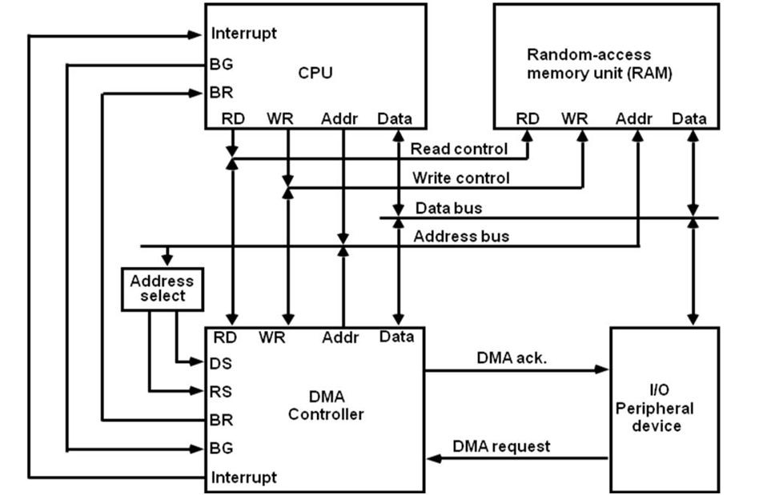
DMA transfer in a computer system

Slide 19
DMA OPERATION
CPU tells DMA controller:
Read/Write
Device address
Starting address of memory block for data o Amount of data to be transferred
CPU carries on with other work
DMA controller deals with transfer
DMA controller sends interrupt when finished

Slide 20
References
Reference Books:
J.P. Hayes, “Computer Architecture and Organization”, Third Edition.
Mano, M., “Computer System Architecture”, Third Edition, Prentice Hall.
Stallings, W., “Computer Organization and Architecture”, Eighth Edition, Pearson Education.
Text Books:
Carpinelli J.D,” Computer systems organization &Architecture”, Fourth Edition, Addison Wesley.
Patterson and Hennessy, “Computer Architecture”, Fifth Edition Morgaon Kauffman.

Slide 21
Other References
http://www.ecs.csun.edu/~cputnam/Comp546/Input-Output-Web.pdf
http://www.ioenotes.edu.np/media/notes/computer-organization-and-architecture- coa/Chapter7-Input-Output-Organization.pdf
https://www.geeksforgeeks.org/io-interface-interrupt-dma-mode/
I/O Interface (Interrupt and DMA Mode) - GeeksforGeeks

